Slide 1
AI Chips - A Brief Introduction

Slide 2
Overview
1. Brief Introduction
2. Top Players and Their Chip Architecture
Graphcore IPU
Tenstorrent
Cerebras WSE
Google TPU
Huawei 910/310
Alibaba Hanguang800
3. Leverage the advantage of CIM
Competitor -- Mythic

Slide 3
Brief Introduction
Scalar
CPU
Vector
CPU + AVX512
GPU
What is next??
What is next??

Slide 4
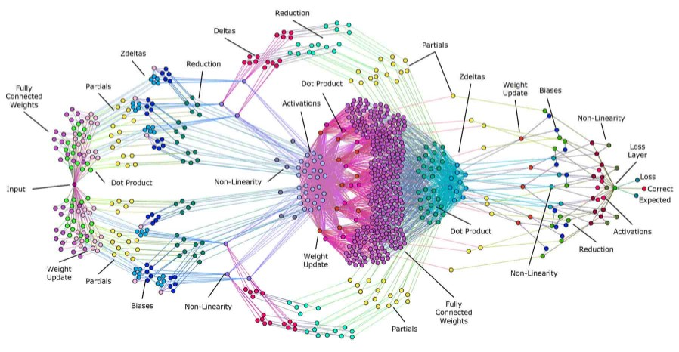
Brief Introduction
Scalar
CPU
Vector
CPU + AVX512
GPU
Graph
Graphcore IPU
Tenstorrent GraySkull
Cerebras WSE
Neural network is DAG (Directed Acyclic Graph).

Slide 5
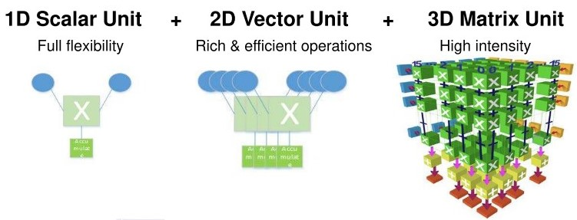
Brief Introduction
Scalar
CPU
Vector
CPU + AVX512
GPU
Matrix/Tensor
Google TPU (systolic array)
Huawei Ascend 910/310 (CUBE)
Alibaba Hanguang800 (Tensor Engine)
Nvidia GPU + TensorCore
Matrix multiple dominates neural network calculations.

Slide 6
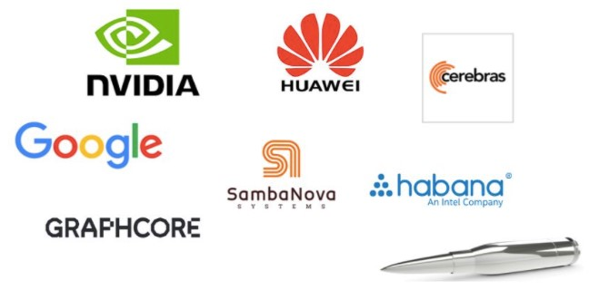
Top Players and Their Chip Architecture

Slide 7

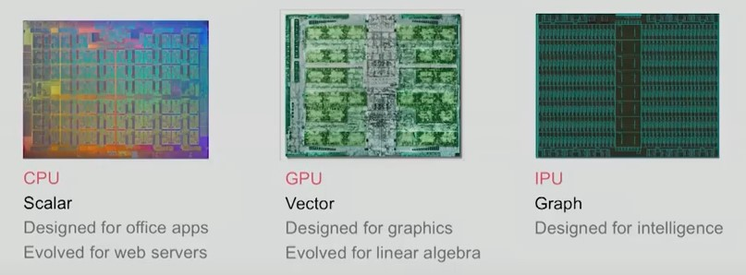
Top Players – Graphcore IPU
Simon Knowles, CTO Graphcore
IPU is built for graph and designed for intelligence.

Slide 8
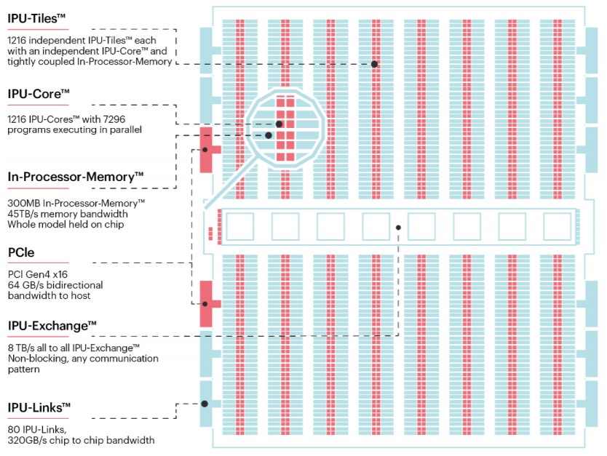
Top Players – Graphcore IPU
Compute
1216 IPU-tiles (small cores)
Special MAC unit
Memory
300MB on-chip SRAM
256KB local SRAM per tile
45TB/s memory bandwidth
37GB/s memory BW per tile
No external DRAM
Communication
8TB/s no-blocking all-to-all exchange

Slide 9
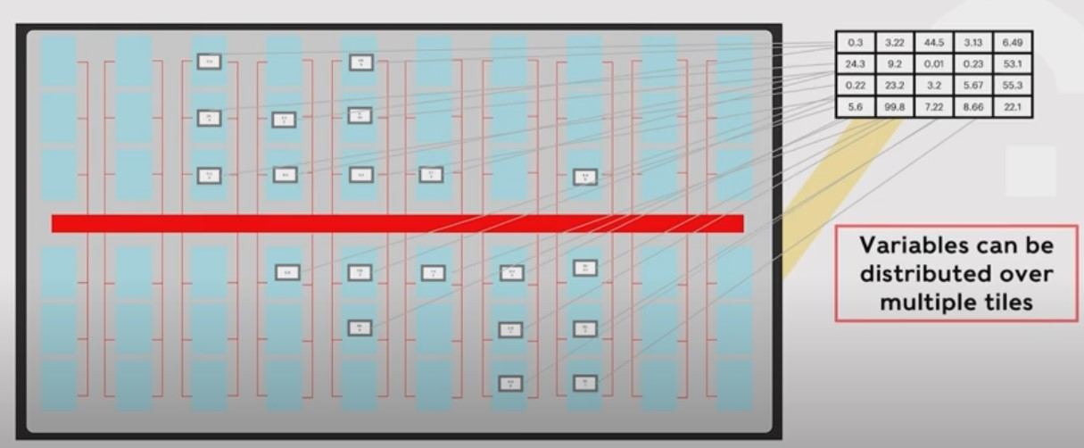
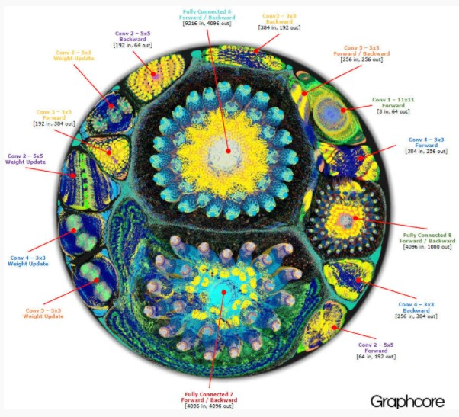
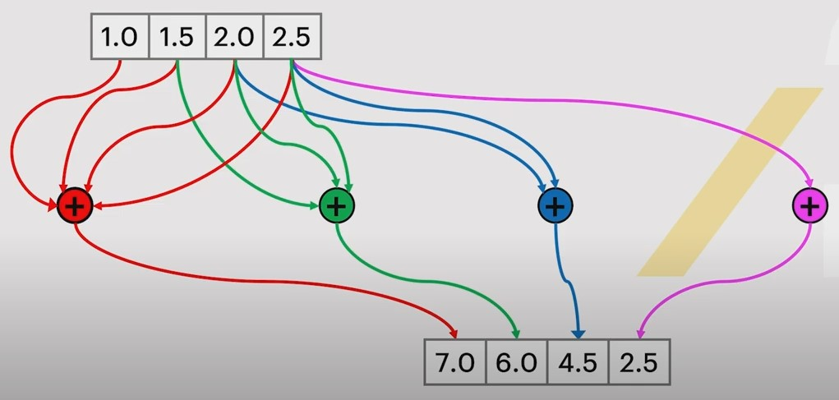
Top Players – Graphcore IPU
IPU is built for graph （Computation is a graph）.
https://www.youtube.com/watch?v=k_jR7DfN67c

Slide 10
Top Players – Graphcore IPU
Takeaways
Graph processor
Computation: Multicore architecture
Memory: Near memory computation (300MB distributed on-chip SRAM and no external DRAM)
Interconnect / Network: 8TB/s no-blocking all-to-all exchange

Slide 11

Top Players – Tenstorrent GraySkull
“GPU was built for running programs on pixels not executing graphs. Tenstorrent builds processor to run graph natively.” -- Jim Keller
Jim Keller is the first investor of Tenstorrent and he is the CTO of this company now.
https://www.youtube.com/watch?v=G4hL5Om4IJ4

Slide 12
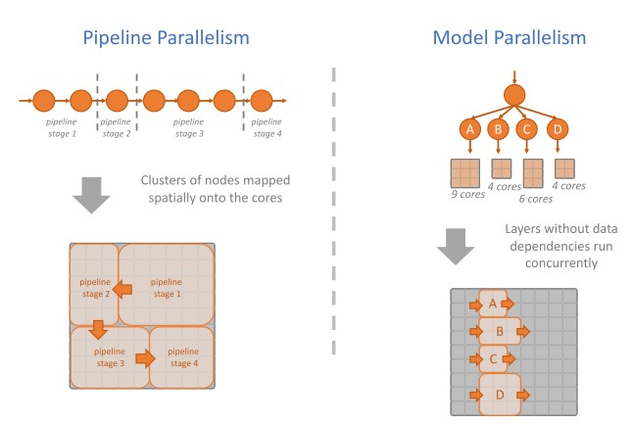
Top Players – Tenstorrent GraySkull
“Tenstorrent builds processor to run graph natively.” -- Jim Keller

Slide 13
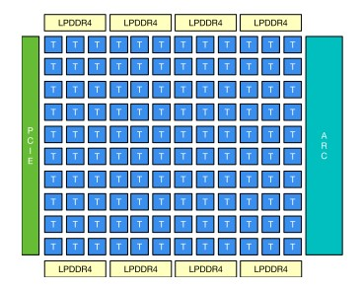
Top Players – Tenstorrent GraySkull
Compute
120 cores
Vector, SIMD
Memory
>120MB on-chip SRAM
1MB local SRAM per core
84TB/s memory bandwidth
~700 GB/s memory BW per core
External DRAM
Communication
330GB/s NoC bandwidth

Slide 14
Top Players – Tenstorrent GraySkull
Takeaways
Graph processor
Computation: Multicore architecture
Memory: >120MB on-chip SRAM and external DRAM
Interconnect / Network: 330GB/s NoC bandwidth

Slide 15
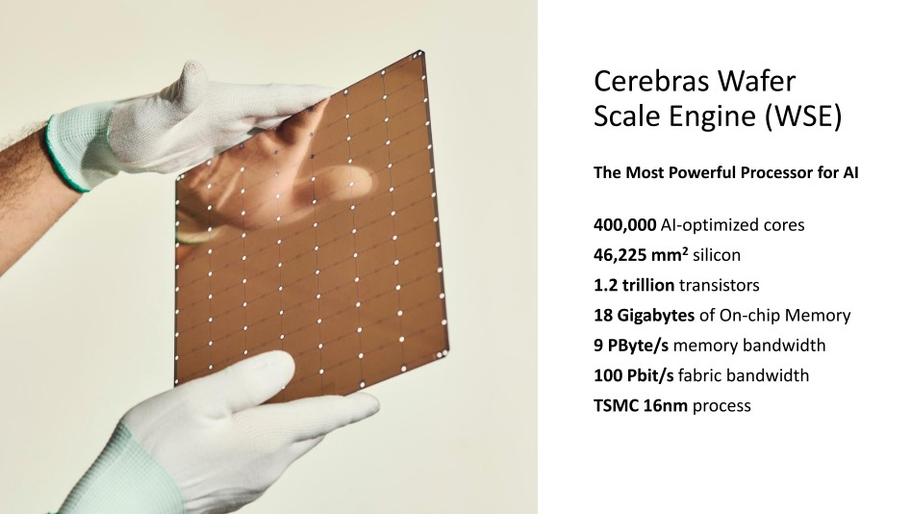
Top Players – Cerebras WSE

Slide 16
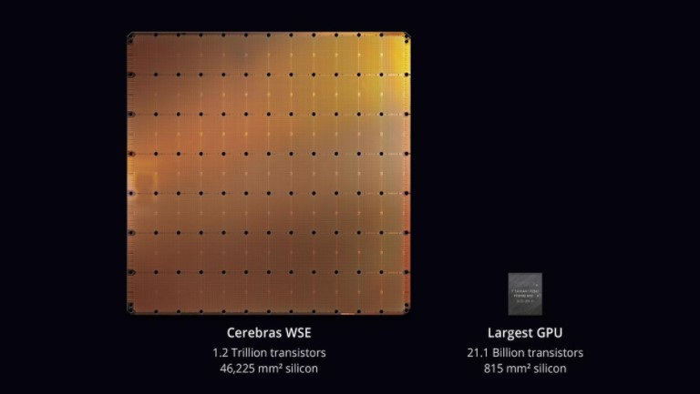
Top Players – Cerebras WSE

Slide 17
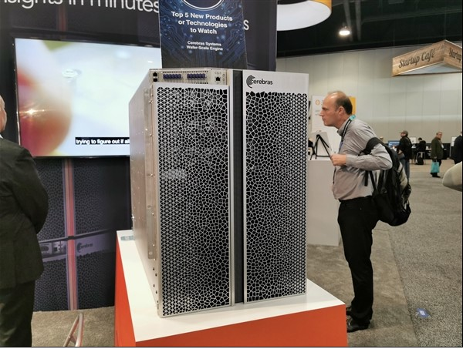
Top Players – Cerebras WSE

Slide 18
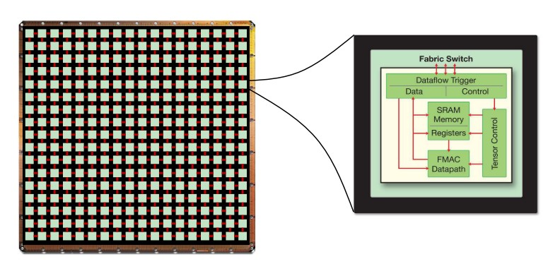
Top Players – Cerebras WSE
2D mesh NoC

Slide 19
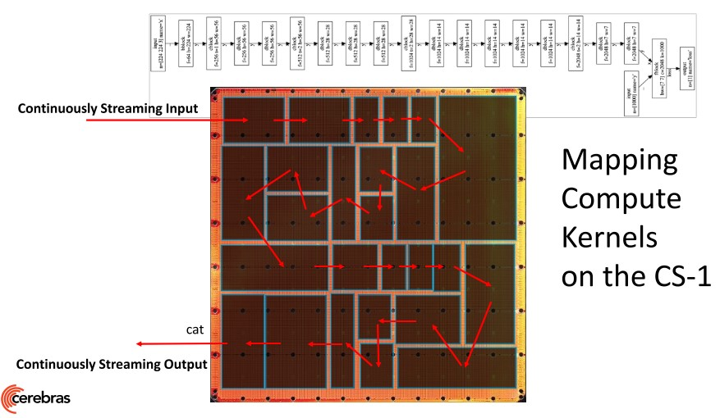
Top Players – Cerebras WSE

Slide 20
Top Players – Cerebras WSE
Takeaways
Wafer Scale Engine
Wafer Scale Engine
Wafer Scale Engine

Slide 21
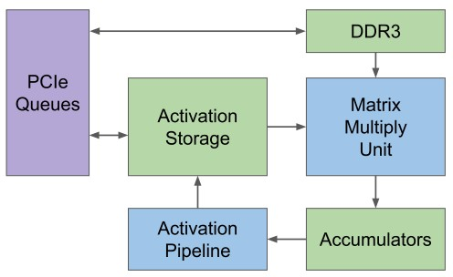
Top Players – Google TPU
DDR3
Store models (kernels / weights)
Matrix Multiply Unit
MAC
Accumulators
Accumulation
Activation Pipeline
BN, ResAdd, sigmoid, Relu…
Activation Storage
Store feature map

Slide 22
Top Players – Google TPU
DDR3 ->（DDR4?）
Store models (kernels / weights)
Matrix Multiply Unit -> (CIM)
MAC
Accumulators -> (Psum Adder)
Accumulation
Activation Pipeline -> (SFU)
BN, ResAdd, sigmoid, Relu…
Activation Storage -> (8MB SRAM)
Store feature map

Slide 23
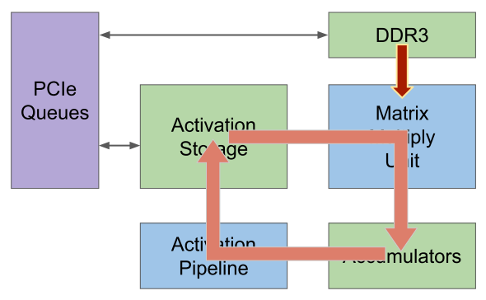
Top Players – Google TPU
CONV data & computation flow
(1) Load weight ->
(2) MAC ->
(3) Accumulator ->
(4) BN, ResAdd, sigmoid, relu… ->
(5) Store feature map
1
5
2
4
3

Slide 24
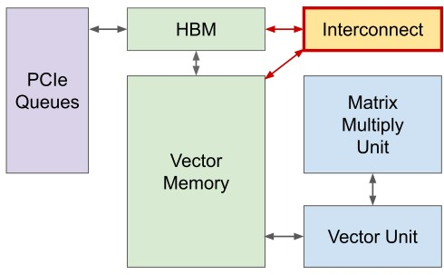
Top Players – Google TPU
Changes from TPUv1 to TPUV2
Single vector memory instead of buffers
General purpose vector unit instead of a fixed activation pipeline
Connect matrix unit as an offload for the vector unit
Move to HBM for bandwidth
Add interconnect for scaling

Slide 25
Top Players – Google TPU
Takeaways
For simplicity, accumulator + activation pipeline (BN, ResAdd, Relu…) is good choice.
For generality, vector unit + vector memory is a good choice.

Slide 26

Leverage the advantage of CIM/PIM

Slide 27
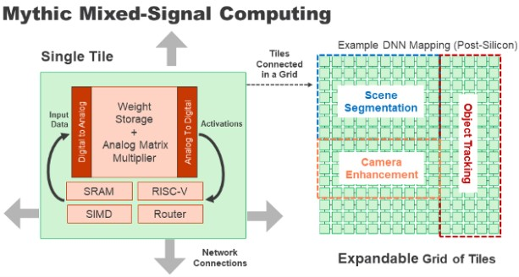
Leverage the advantage of CIM/PIM
The advantage of CIM/PIM:
Never pay the energy of reading the weights
Only pay the energy of performing the MAC ops
Mythic – Good Design Reference
CIM /PIM
Matrix Multiplying Memory (never read weights)
SIMD unit
RISC-V
120 Tiles
NoC interconnect
No DRAM

Slide 28
Leverage the advantage of CIM
What?
CIM
– Eliminate the need of weights movement
– High computation density
Who / Who’ll buy?
Data center
Why / Why they buy?
Power efficiency

Slide 29

Questions?

Slide 30
Thank you!

Slide 31
Backup

Slide 32
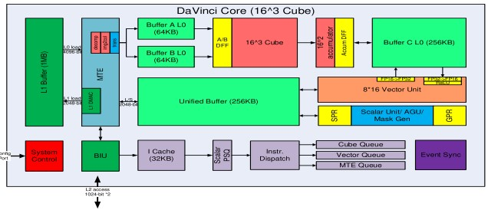
Top Players – Huawei Da Vinci
CUBE
8190 INT8 MACs
MTE
Memory Transfer Engine
Explicit memory hierarchy design
Vector Unit
2048bit vector
Special functions:
NMS
ROI
SORT

Slide 33
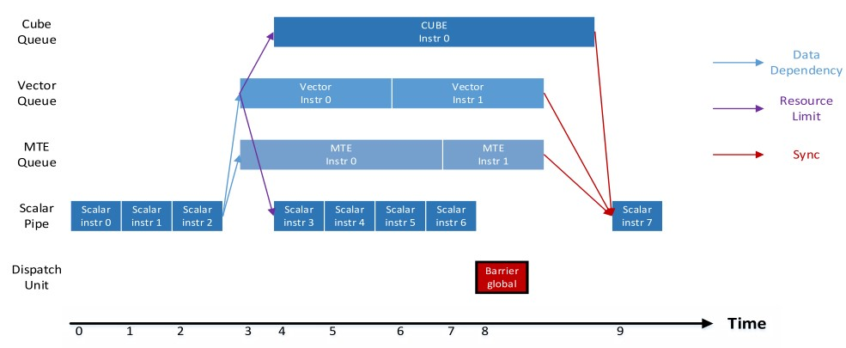
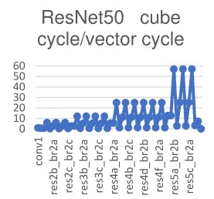
Top Players – Huawei Da Vinci
Multi-thread hardware
The First layer is executed on vector unit
Balance computation power between CUBE vs Vector by overlapping its computation time with Vector
Carefully allocated the number of MACs in CUBE and Vectors

Slide 34
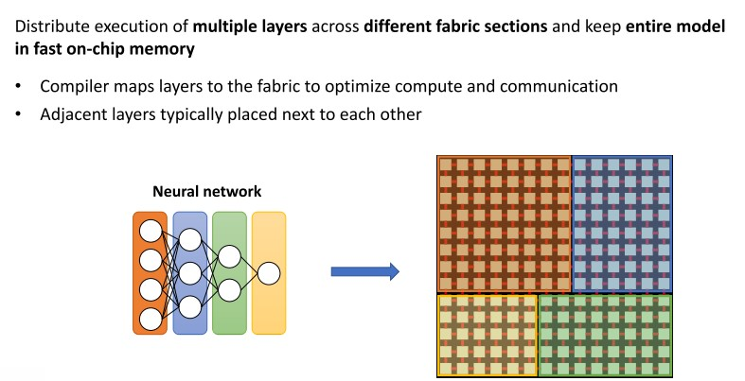
Top Players – Cerebras WSE

Slide 35
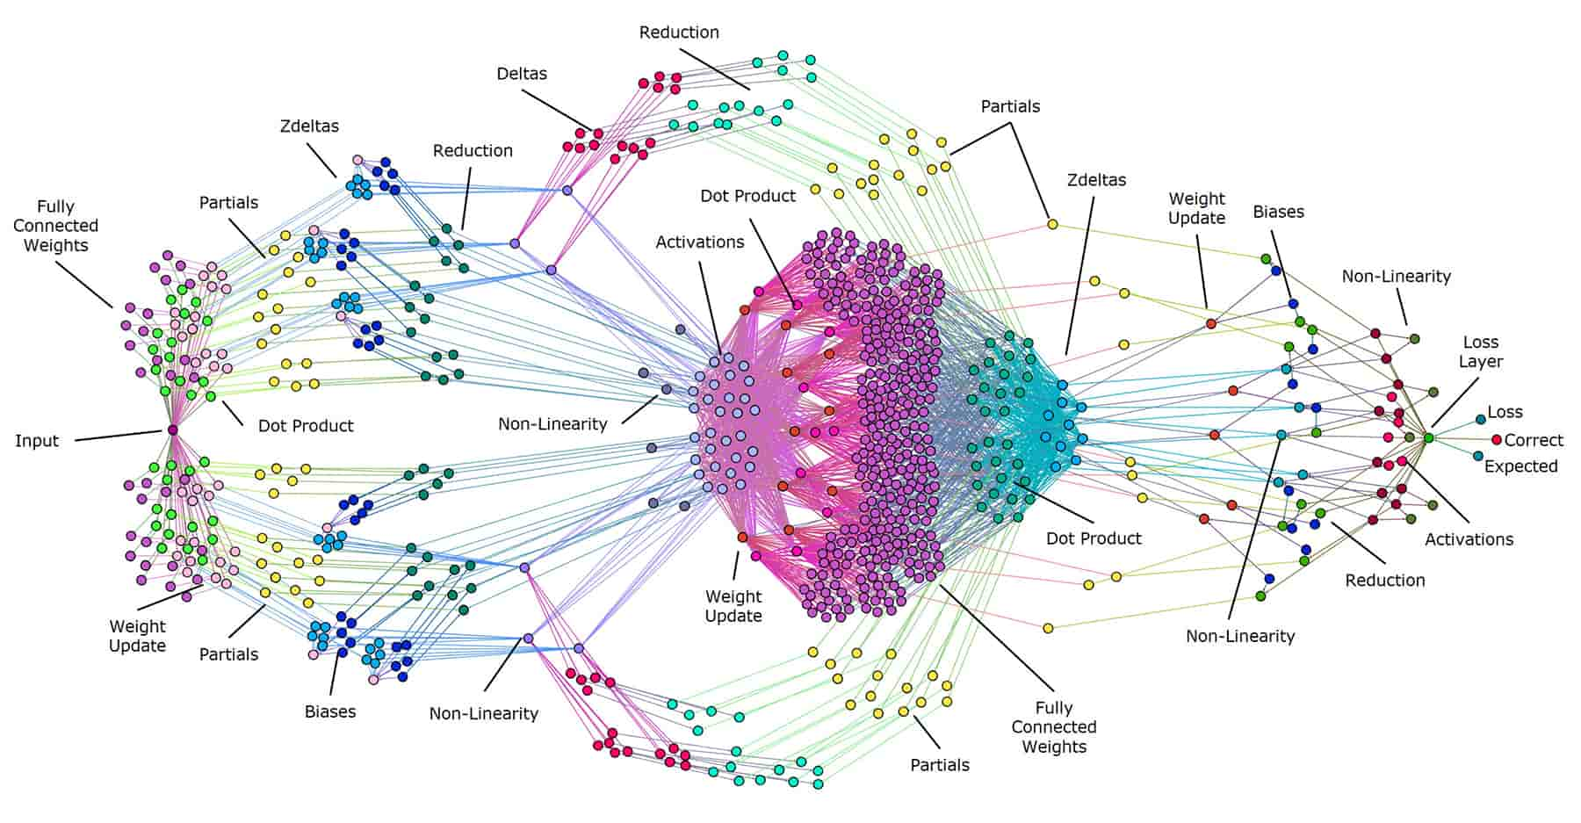

Slide 36
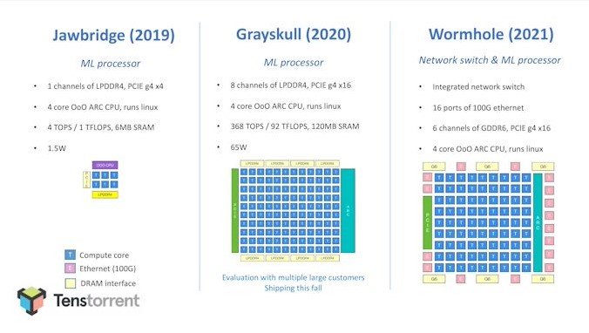
Roadmap of Tenstorrent’s processor

